Slide 1


STAFF GRID

Slide 2


STAFF GRID
TEAM MEMBERS
SWAYAM HINGU
PARI CHAUHAN
KASHYAP TRIVEDI
AVINASH BARAIYA
JEET PATEL
KISAN THAKOR
CHIRAG CHAUDHARI
KSHITIJ PATEL
HEMAL RAVRANI
RIDDHI MISTRY
PARTH PRAJAPATI
202201207 ( LEADER)
202201189
202201191
202201211
202201216
202201217
202201219
202201232
202201235
202201238
202201250
LINKS
CONTRIBUTION LINK
WEBSITE LINK
GITHUB LINK
YOUTUBE VIDEO LINK

Slide 3







STAFF GRID
OBJECTIVES
The Employee Management System aims to simplify operations for employees,HR, Managers,Admin allowing them to manage leaves, attendance, projects, and profiles effortlessly.
The system provides a centralized platform for seamless communication and automates processes like attendance tracking and leave approvals.
It enhances productivity by enabling all roles to focus on their core responsibilities.

Slide 4



STAFF GRID
Analyzed the problem statement and conducted research on Employee Management systems.Gathered requirements by consulting various people and took inspiration from ARVIND’s system.
Finalized core functionalities and selected the MERN stack for development.
MILESTONES
Began development, faced challenges with GitHub workflows, but resolved issues through teamwork and persistence.
Start developing step by step with solving some synchronisation problem with frontend and backend.
Integrated modules, conducted testing, and resolved bugs to ensure seamless functionality.

Slide 5
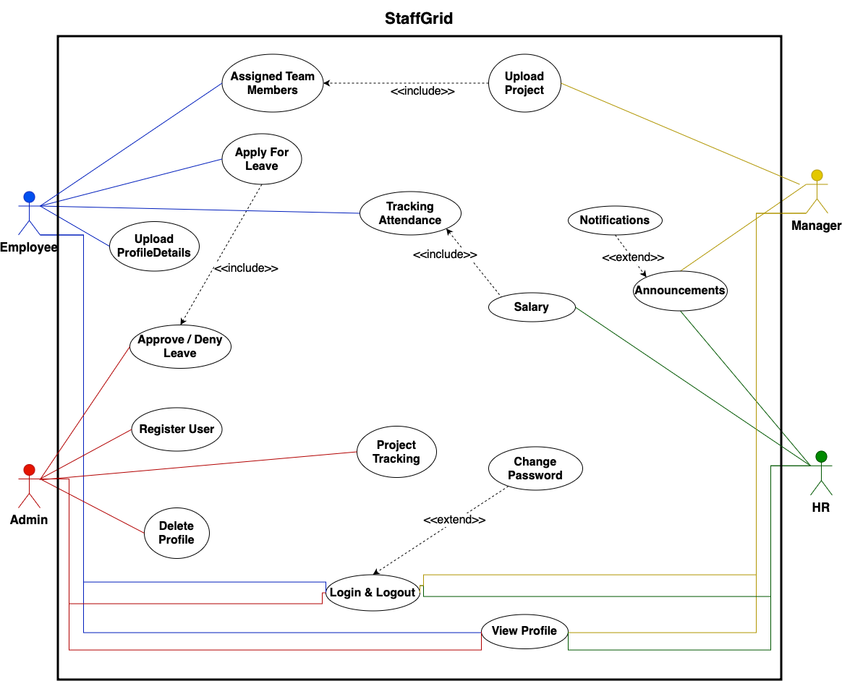
USECASE DIAGRAM

Slide 6






LESSON LEARNT
01
02
03
04
Importance of Clear Requirements
Team Collaboration
Time Management
Problem-Solving Skills
Understanding and defining detailed requirements for different user roles (Employee, Manager, HR, Admin) is critical for success.
Effective communication and coordination among team members play a vital role in meeting project goals.
Following proper timeline for more througthput
Addressing technical challenges,role-based access control
05
06
07
08
Learning New Technologies
Documentation and Maintenance
Experience Gaining
Overall
The project provided an opportunity to learn and apply technologies, frameworks, or methodologies effectively.
Importance of well communication and documentation for smooth maintainance
Maintaining clear documentation simplifies future updates and support.
Learn, How to develop a software from the scrach with all required aspects

Slide 7


STAFF GRID
ACHIEVEMENTS
Gained practical knowledge of the Software Development Life Cycle (SDLC).
I
Improved collaborative teamwork and problem-solving skills.
II
Learned to use GitHub and project management tools efficiently.
III
Successfully implemented a user-friendly Employee Management System with key functionalities.
IV
Enhanced technical expertise in the MERN stack through hands-on development.
V

Slide 8


STAFF GRID
MISTAKES
Inconsistency in CSS design
Asynchronous behavior in FRONTEND & BACKEND in initial phase
Implementation started without proper system design and planning

Slide 9





STAFF GRID
RATING OF SOFTWARE ARTEFACT
(0-5)
Design & Documentation
4
4.5
PROJECT MANAGEMENT
4.5
4
CODE ARTEFACT
TESTING AND TESTCASES
4.5
OVERALL RATING

Slide 10

STAFF GRID
9
OVERALL RATING OF PROJECT
(0-10)

